Slide 1
Library Database
Anees Rehman

Slide 2
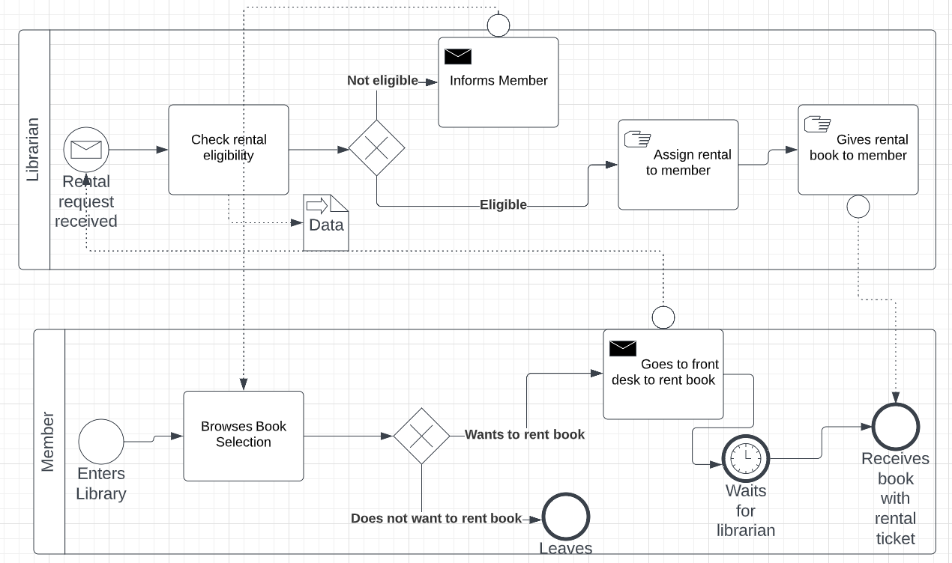
Business Process Model

Slide 3
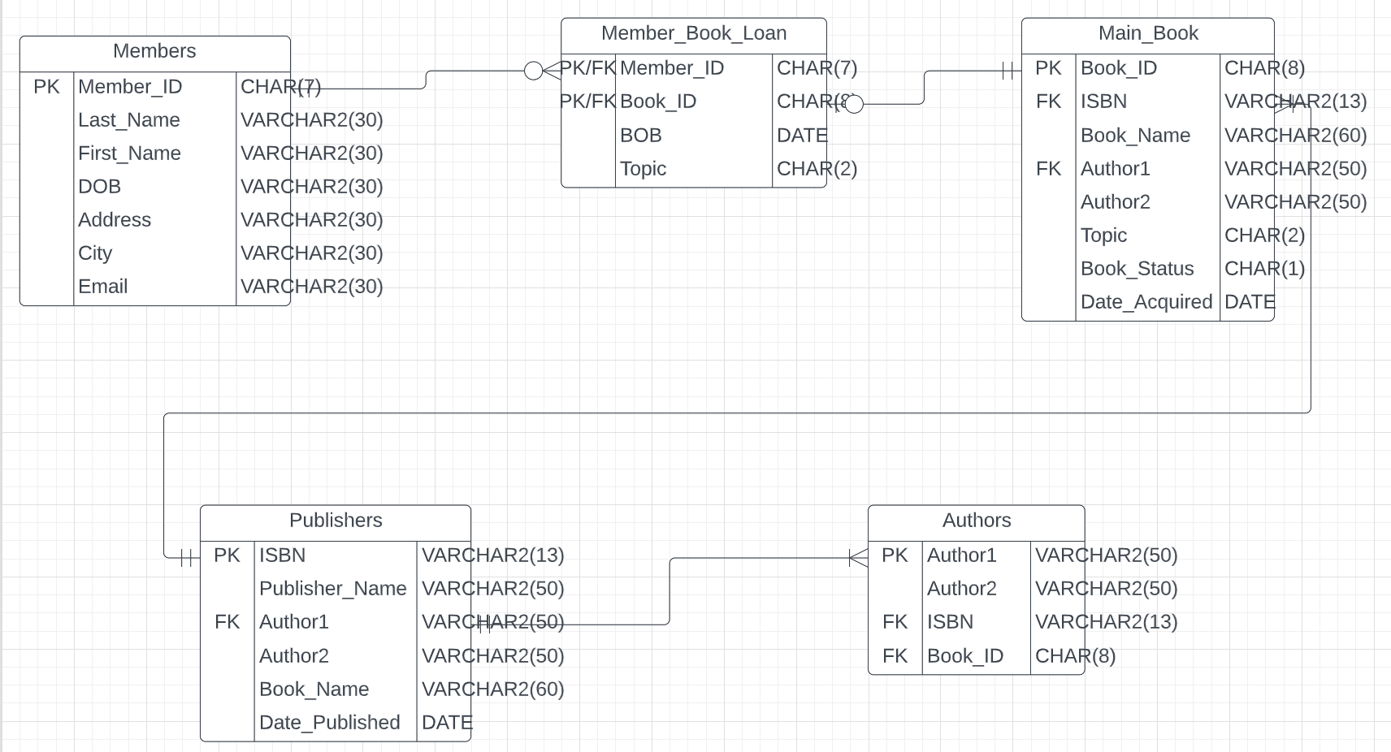
Entity Relationship Diagram

Slide 4
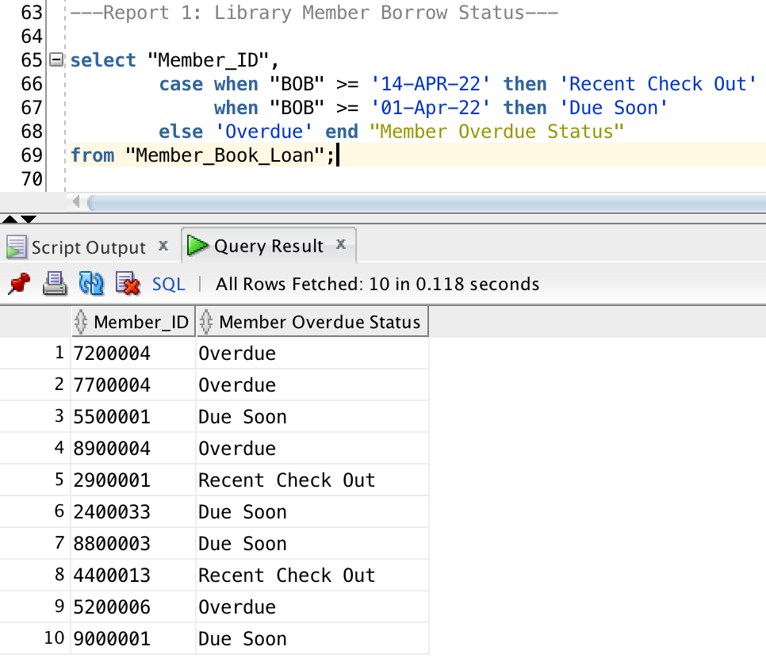
Report 1: Library Member Borrow Status

Slide 5
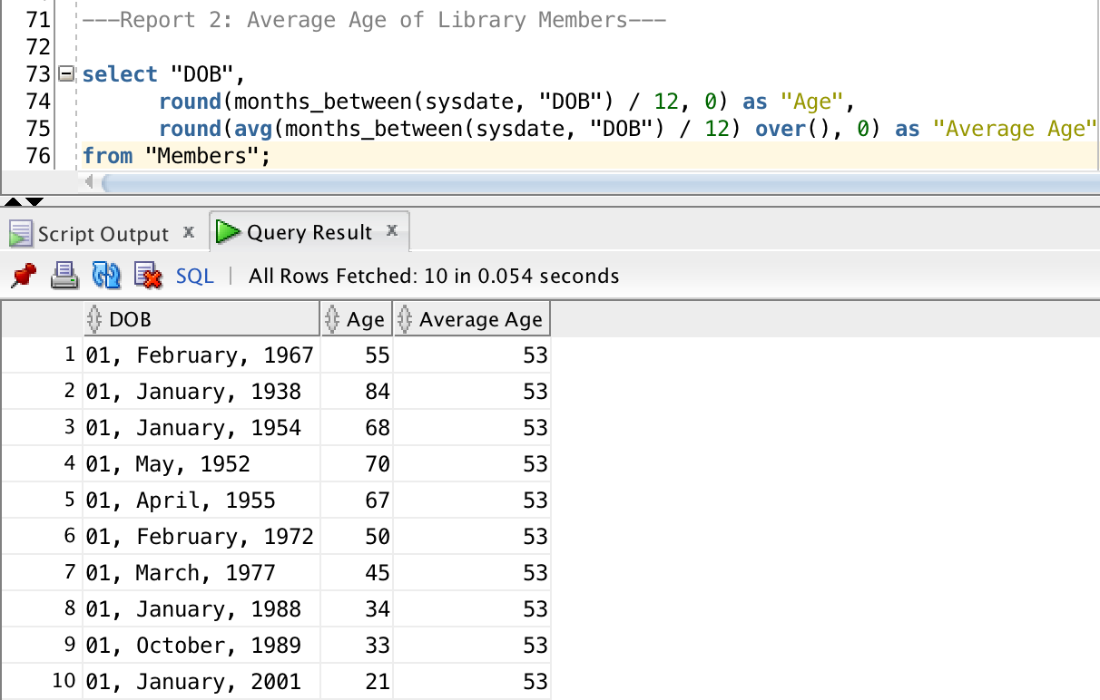
Report 2: Average Age of Library Members

Slide 6
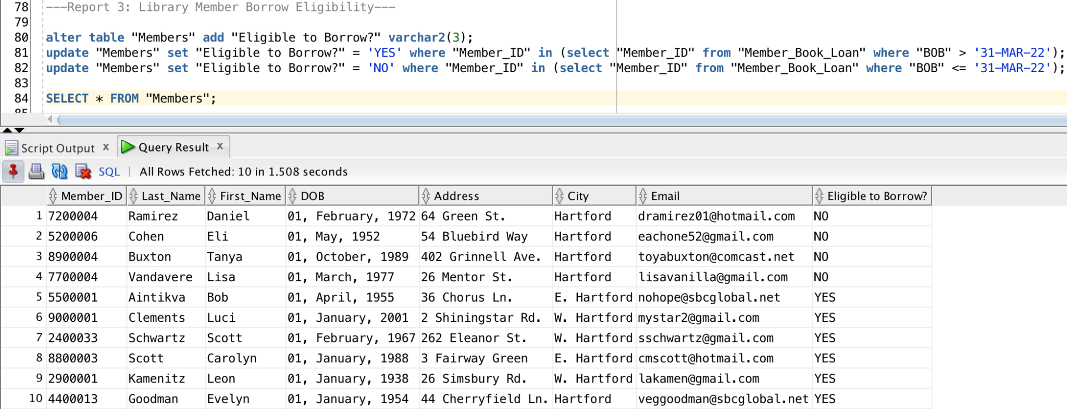
Report 3: Library Member Borrow Eligibility

Slide 7
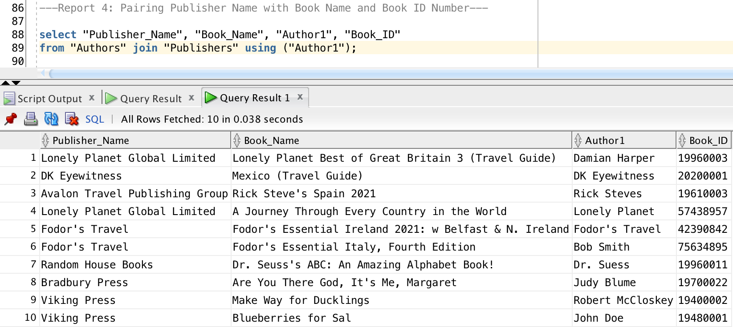
Report 4: Pairing Publisher Name with Book Name and Book ID Number

Slide 8
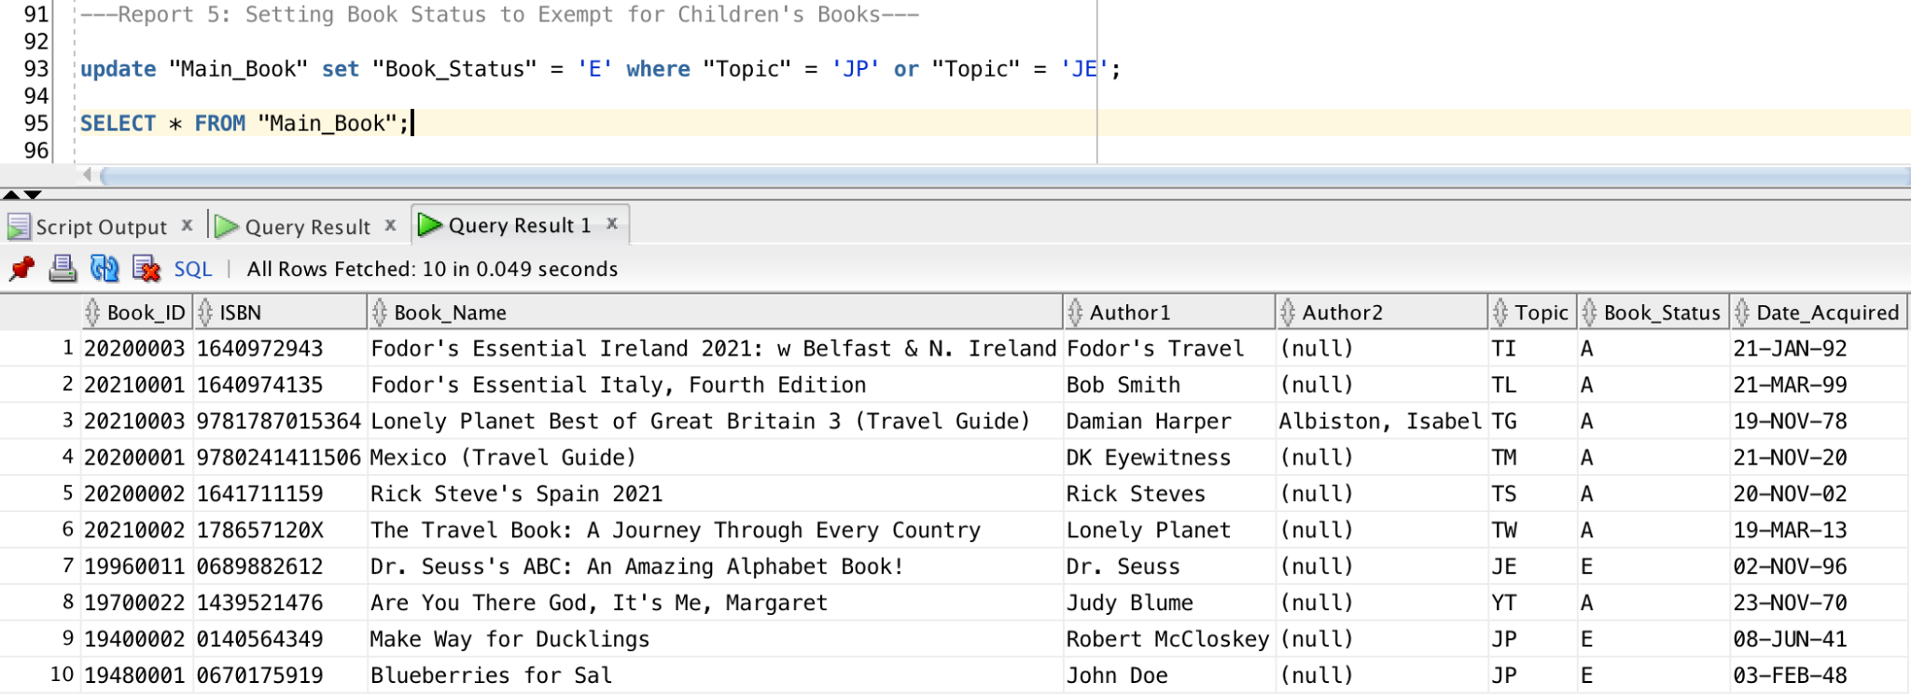
Report 5: Setting Book Status to Exempt for Children's Books

Slide 9
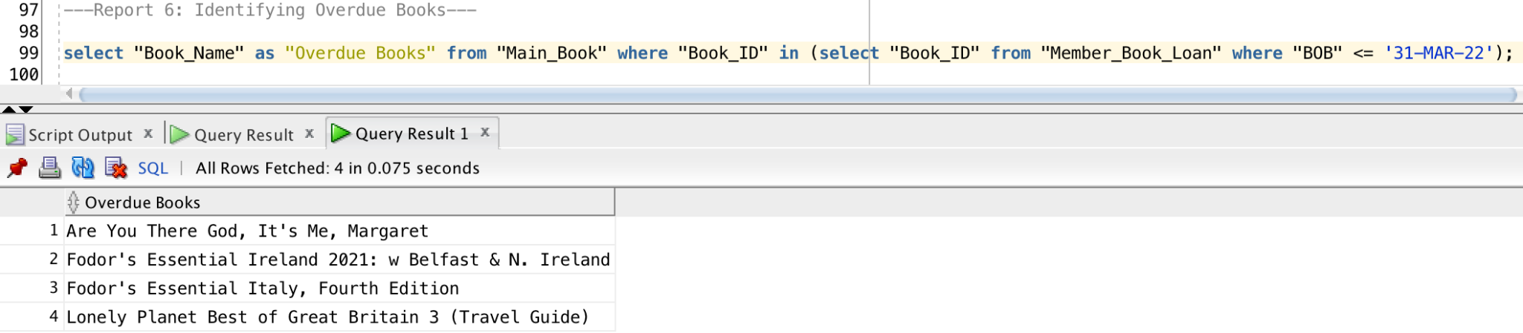
Report 6: Identifying Overdue Books

Slide 10
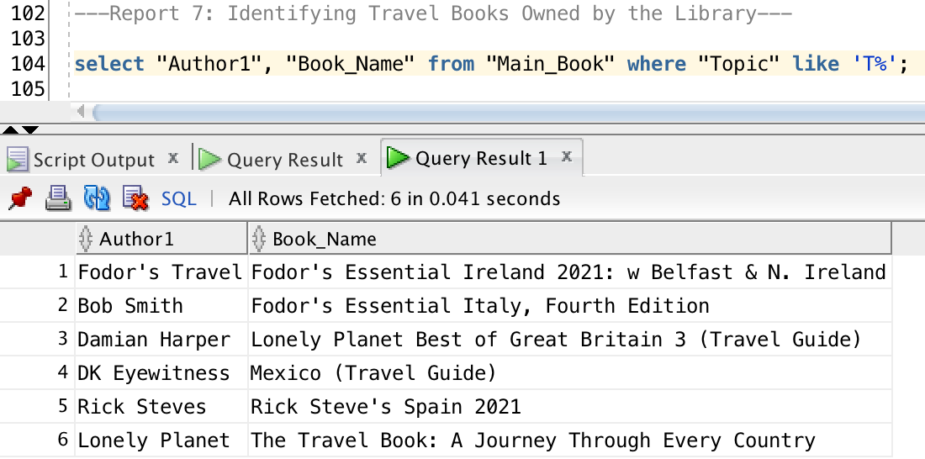
Report 7: Identifying Travel Books Owned by the Library

Slide 11
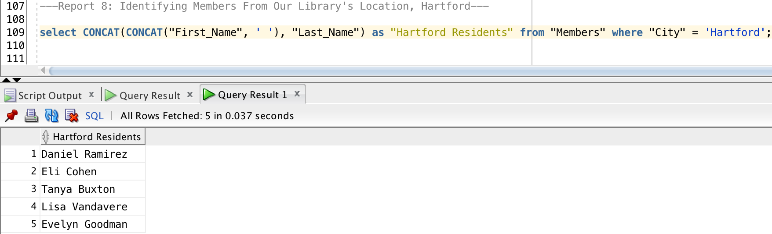
Report 8: Identifying Members From Our Library's Location, Hartford

Slide 12
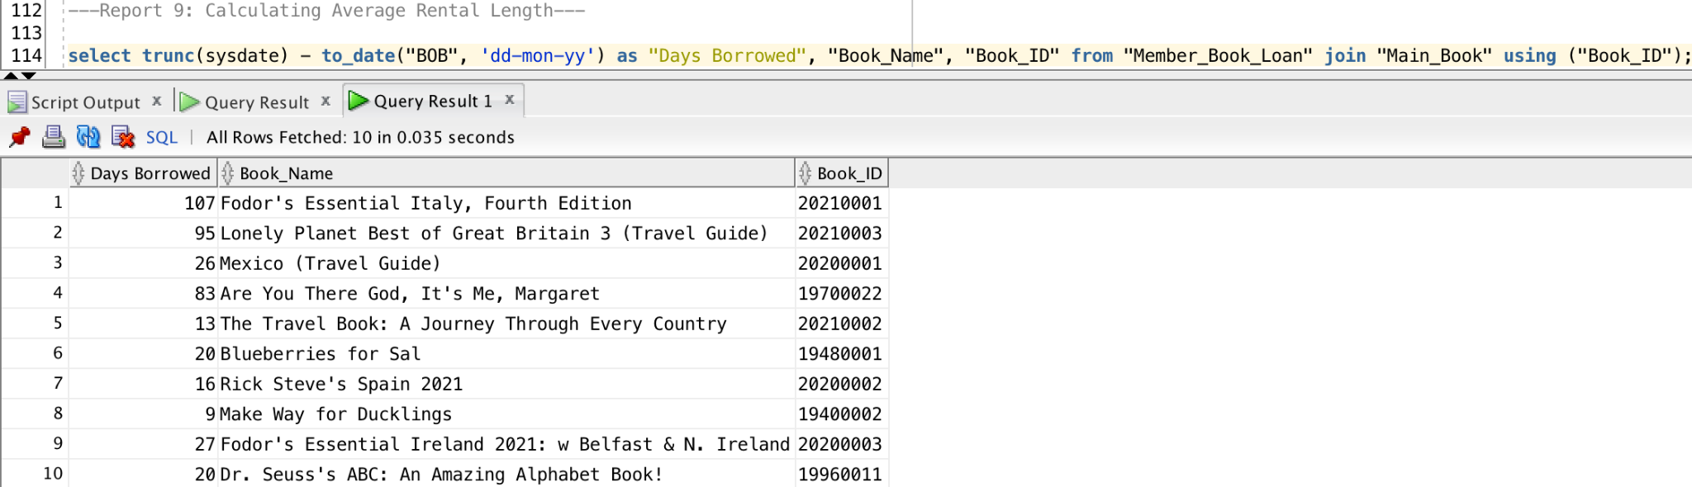
Report 9: Calculating Average Rental Length

